Slide 1
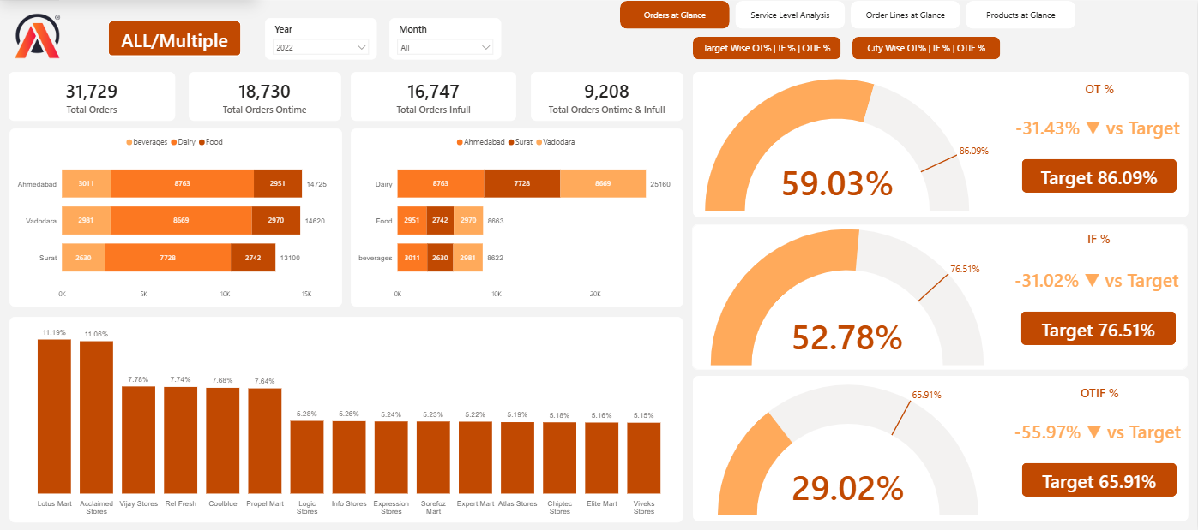
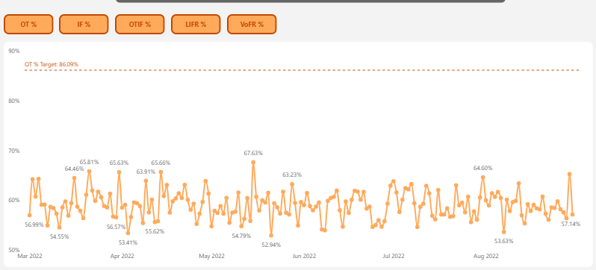
Supply Chain Insights and Key Findings
Created by
Muhammad Faizan

Slide 2
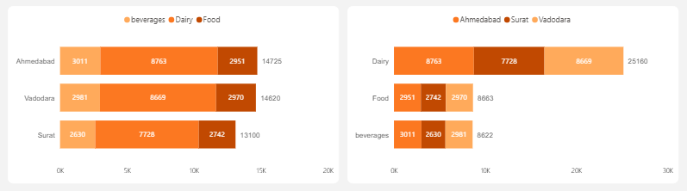
Insights and Key Findings
Ahmedabad has been top selling city Dairy Products orders are almost double than the other categories

Slide 3
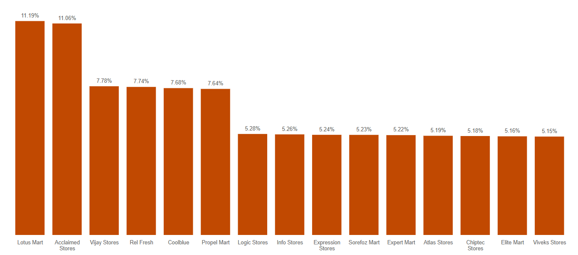
Insights and Key Findings
First 6 Customers Acclaimed Stores , Lotus Mart, Vijay Stores, Rel Fresh, Cool Blue & Propel Mart is constituting 53% of Total orders & seems to be key customers

Slide 4
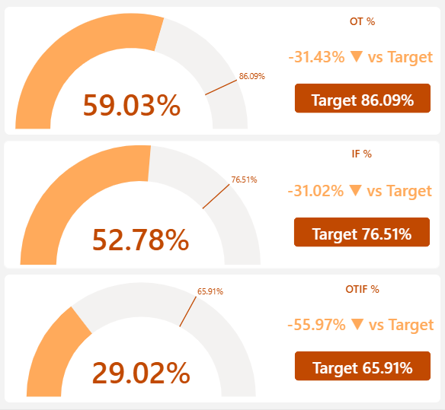
Insights and Key Findings
OT%, IF% and OTIF% are noticeably lower than the Targeted levels.

Slide 5
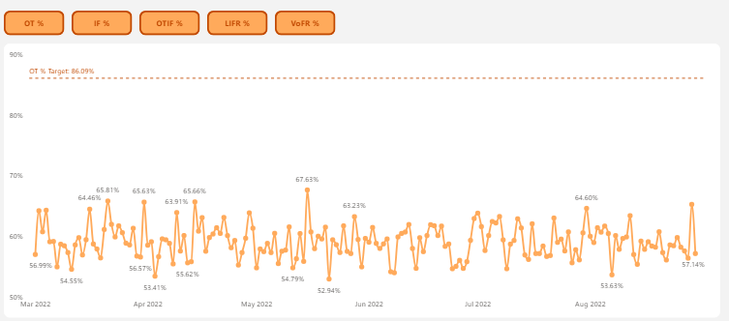
Insights and Key Findings
In Daily Trend for OT% Graphs for Order even Daily level of OT% too are significantly lower than Targeted OT%

Slide 6
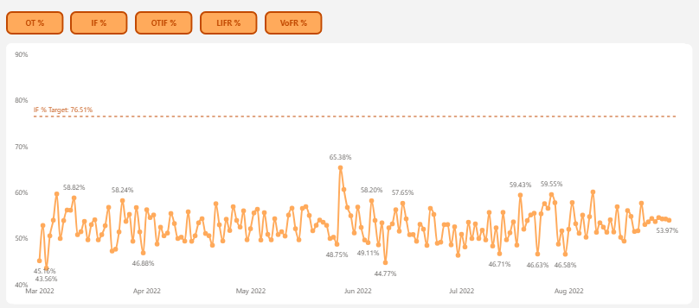
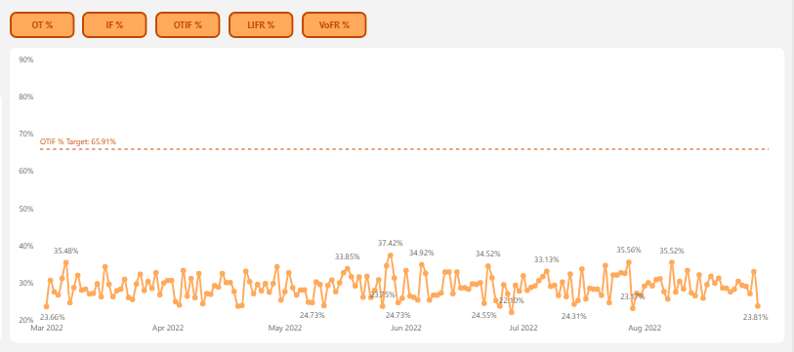
Insights and Key Findings
Even Daily trends of IF% and OTIF % chart shows that not a single day they are able to touch the Target lines for respective matrices . Especially OTIF% performance is quite disappointing.

Slide 7
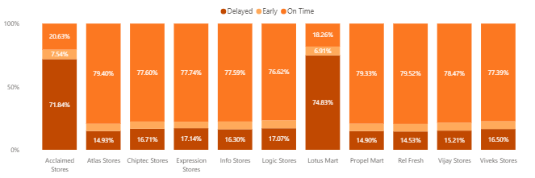
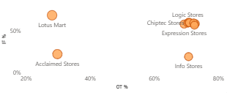
Insights and Key Findings
SURAT City
When service levels are filtered for SURAT city Lotus Mart and Acclaimed Stores shows alarming IF% & OTIF % levels.

Slide 8
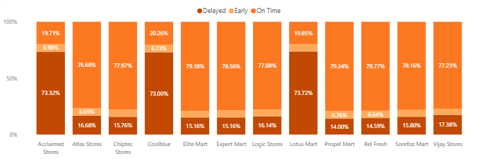
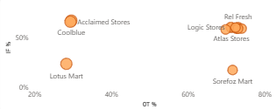
Insights and Key Findings
AHMEDABAD City
When service levels are filtered for Ahmedabad city Lotus Mart, Acclaimed Stores and Coolblue shows alarming IF% & OTIF % levels.

Slide 9
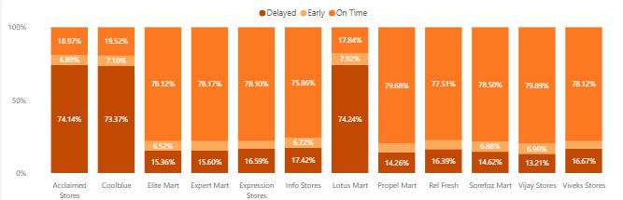
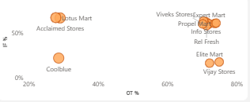
Insights and Key Findings
VADODARA City
When service levels are filtered for Vadodara city Lotus Mart, Acclaimed Stores, Coolblue, Vijay Stores and Elite Mart shows alarming IF% & OTIF % levels.

Slide 10
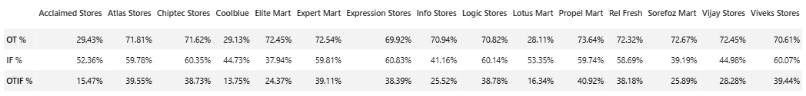
Insights and Key Findings
Service Level Analysis of Orders shows For Acclaimed Stores , Cool Blue & Lotus Mart have some noticeably lower OT% and OTIF % even their IF% too are also not so much convincing.

Slide 11
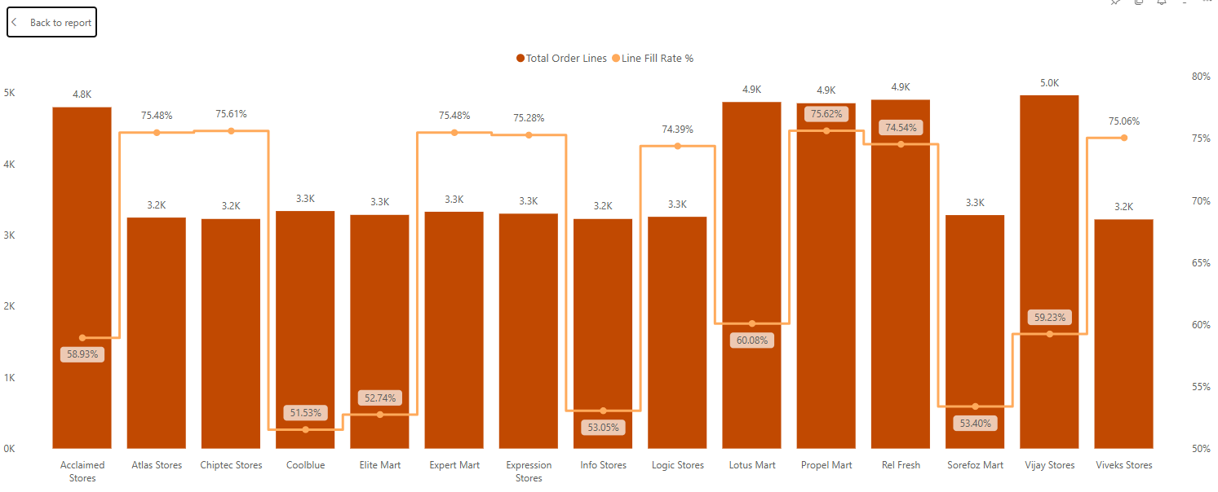
Insights and Key Findings
Initial analysis of Order Line overview shows that there are certain customers who has LIFR % noticeably lower than Average LIFR%.

Slide 12
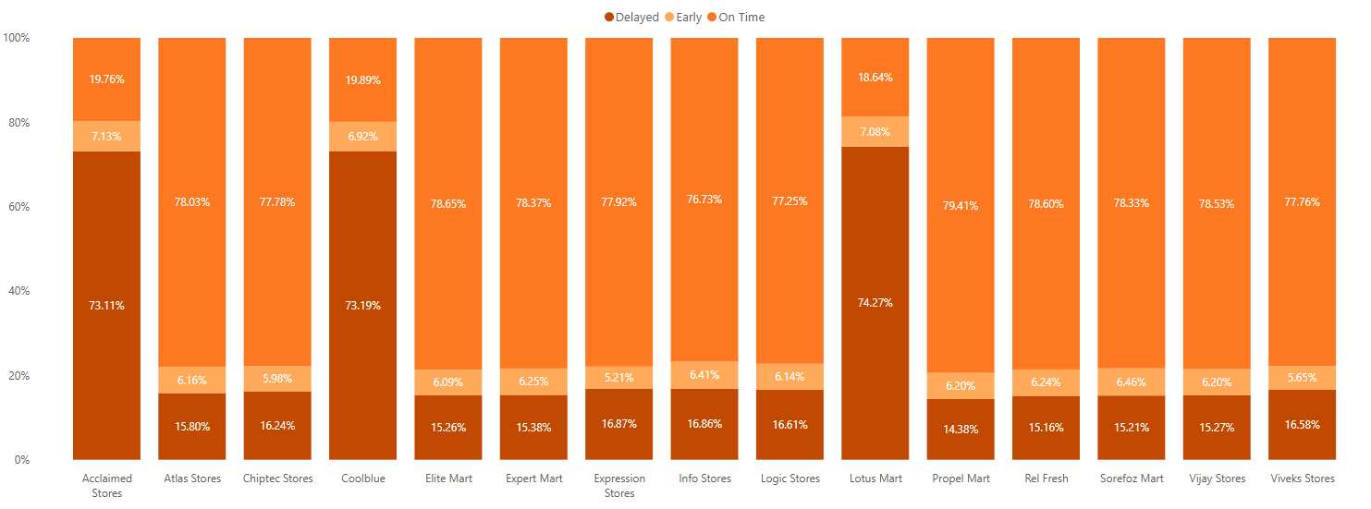
Insights and Key Findings
For Acclaimed Stores , Cool Blue & Lotus Mart more than 70% of times lines are being delivered late

Slide 13
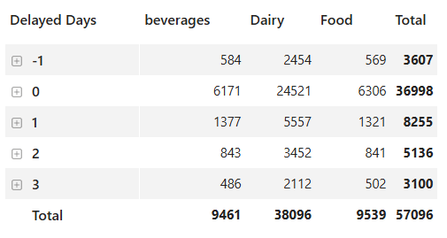
Insights and Key Findings
Dairy products have the most delays, which is risky because they spoil quickly and can cause losses and customer complaints.

Slide 14
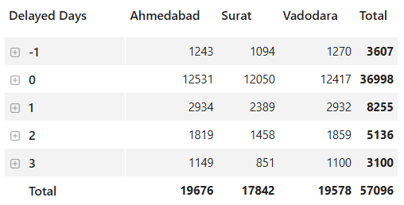
Insights and Key Findings
Delays look the same in all cities, which means the problem is not local but likely coming from a central warehouse or shared logistics provider.

Slide 15
Insights and Key Findings
Delays look the same in all cities, which means the problem is not local but likely coming from a central warehouse or shared logistics provider.

Slide 16
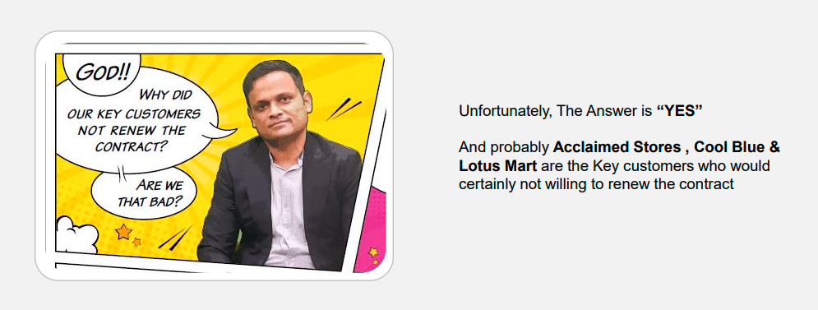
Insights and Key Findings
Note: Some orders arrive earlier than planned, and since customers may not have space available, it can cause issues and shows inconsistent delivery timing.

